Slide 1
Lecture 4
Law of Small Numbers

Slide 2
Consider the following judgment task:
Study of the incidence of kidney cancer in 3141 counties in the USA. The counties in which the incidence of kidney cancer is lowest are mostly rural, sparsely populated, and located in traditionally Republican states in the Midwest, the South and the West.
What do you make of this?
Notes:
Clean living, no pollution, fresh food without additives

Slide 3
Mental Shotgun
This is a thinking problem.
System 2 tries to go to work: Searches memory and forms hypotheses.
System 1 goes to work also: seeks associative coherence and cognitive ease that it recommends to System 2.
Associative machine activates network of associates and attempts to assemble story.
What is the causal coherence that comes to mind?
Notes:
Clean living, no pollution, fresh food without additives. Makes sense – hard for System 2 to refute.

Slide 4
Now consider the following….
Study of the incidence of kidney cancer in 3141 counties in the USA. The counties in which the incidence of kidney cancer is highest are mostly rural, sparsely populated, and located in traditionally Republican states in the Midwest, the South and the West.
What do you make of this?
Notes:
No access to medical care, high fat diet, alcohol, tobacco
Contradicting evidence induced some cognitive strain. Lets relieve it with some help from System 2.

Slide 5
What is happening here….
Imagine a large urn filled with marbles, half are red and half are white.
Consider an experiment where we draw four balls, and record the number of red balls. Then we repeat the experiment many times.
How much more often would we observe the expected outcome of “2 red and 2 blue” in comparison to the extreme outcome “4 red”.

Slide 6
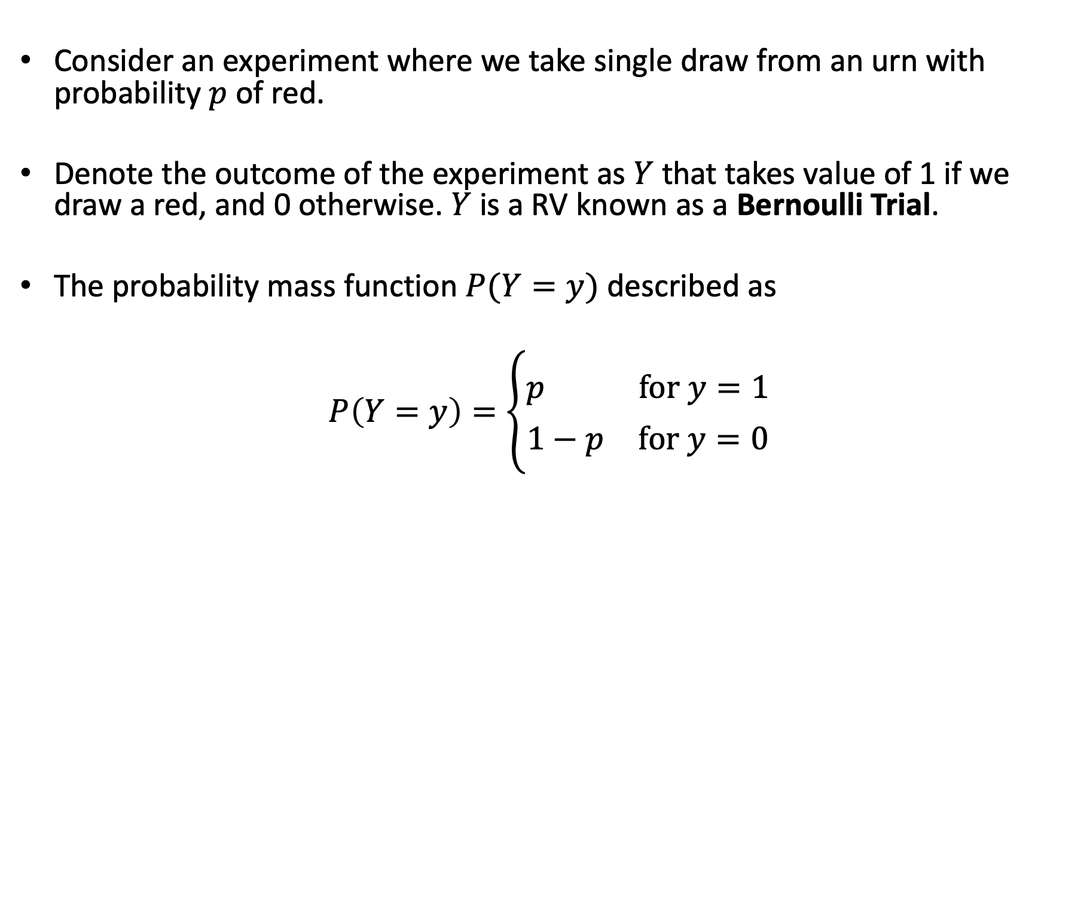
Lets Answer a Simpler Question First…
Consider an experiment where we take single draw from an urn with probability $p$ of red.
Denote the outcome of the experiment as $Y$ that takes value of 1 if we draw a red, and 0 otherwise. $Y$ is a RV known as a Bernoulli Trial.
The probability mass function $P(Y=y)$ described as
$$P\left(Y=y\right)=\left\{\begin{aligned}p for y=1 \\ 1−p for y=0\end{aligned}\right.$$

Slide 7
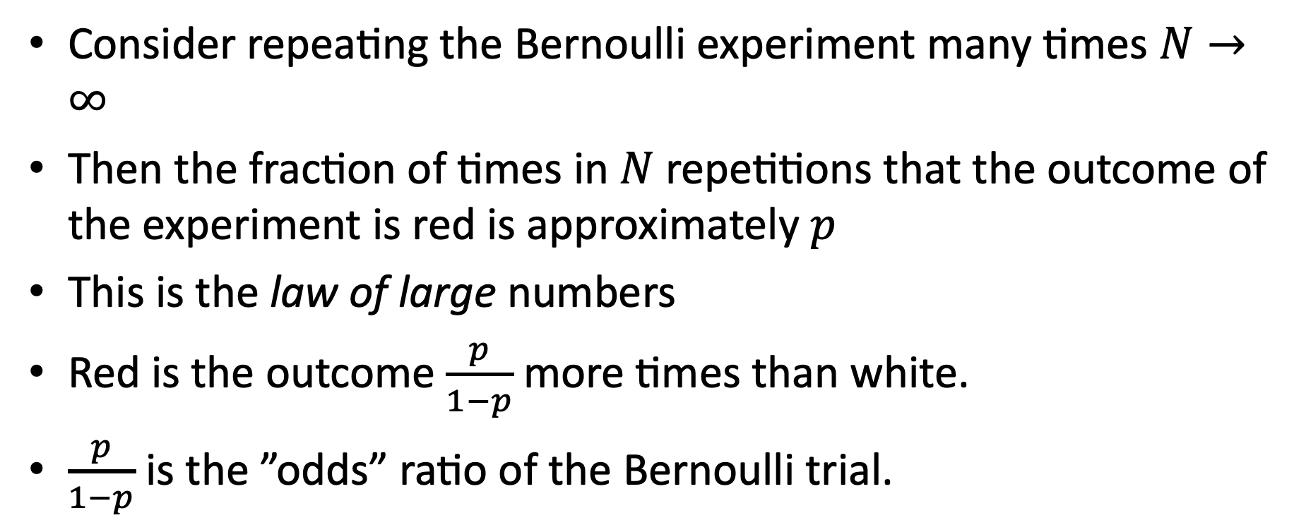
Repeated experiment
Consider repeating the Bernoulli experiment many times $N→∞$
Then the fraction of times in $N$ repetitions that the outcome of the experiment is red is approximately $p$
This is the law of large numbers
Red is the outcome $\frac{p}{1−p}$ more times than white.
$\frac{p}{1−p}$ is the ”odds” ratio of the Bernoulli trial.

Slide 8
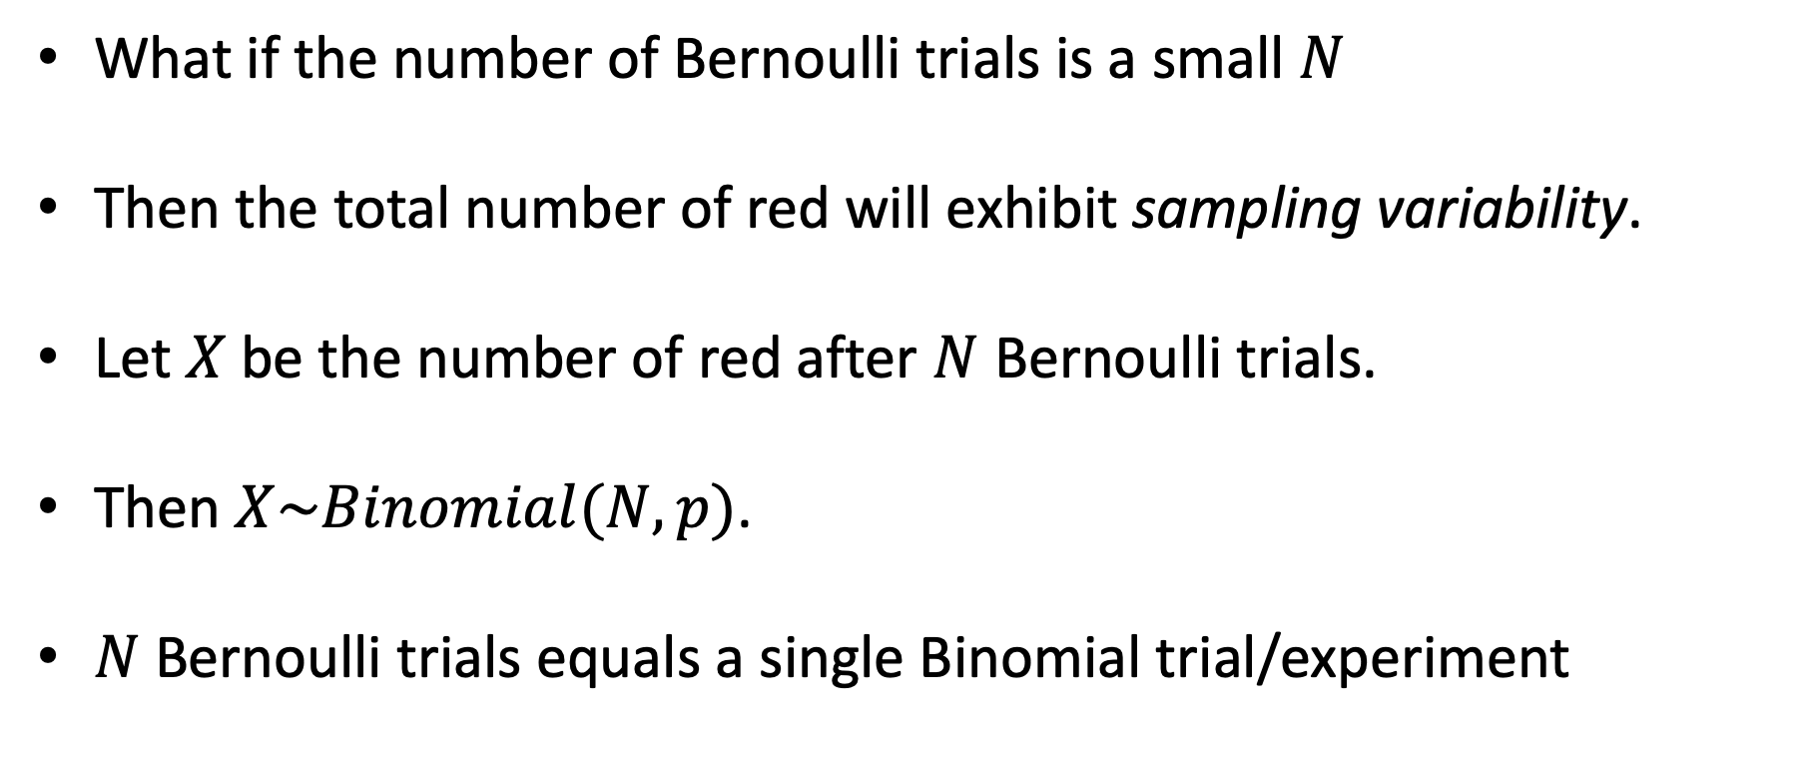
Binomial experiment
What if the number of Bernoulli trials is a small $N$
Then the total number of red will exhibit sampling variability.
Let $X$ be the number of red after $N$ Bernoulli trials.
Then $X\sim Binomial(N,p)$.
$N$ Bernoulli trials equals a single Binomial trial/experiment

Slide 9
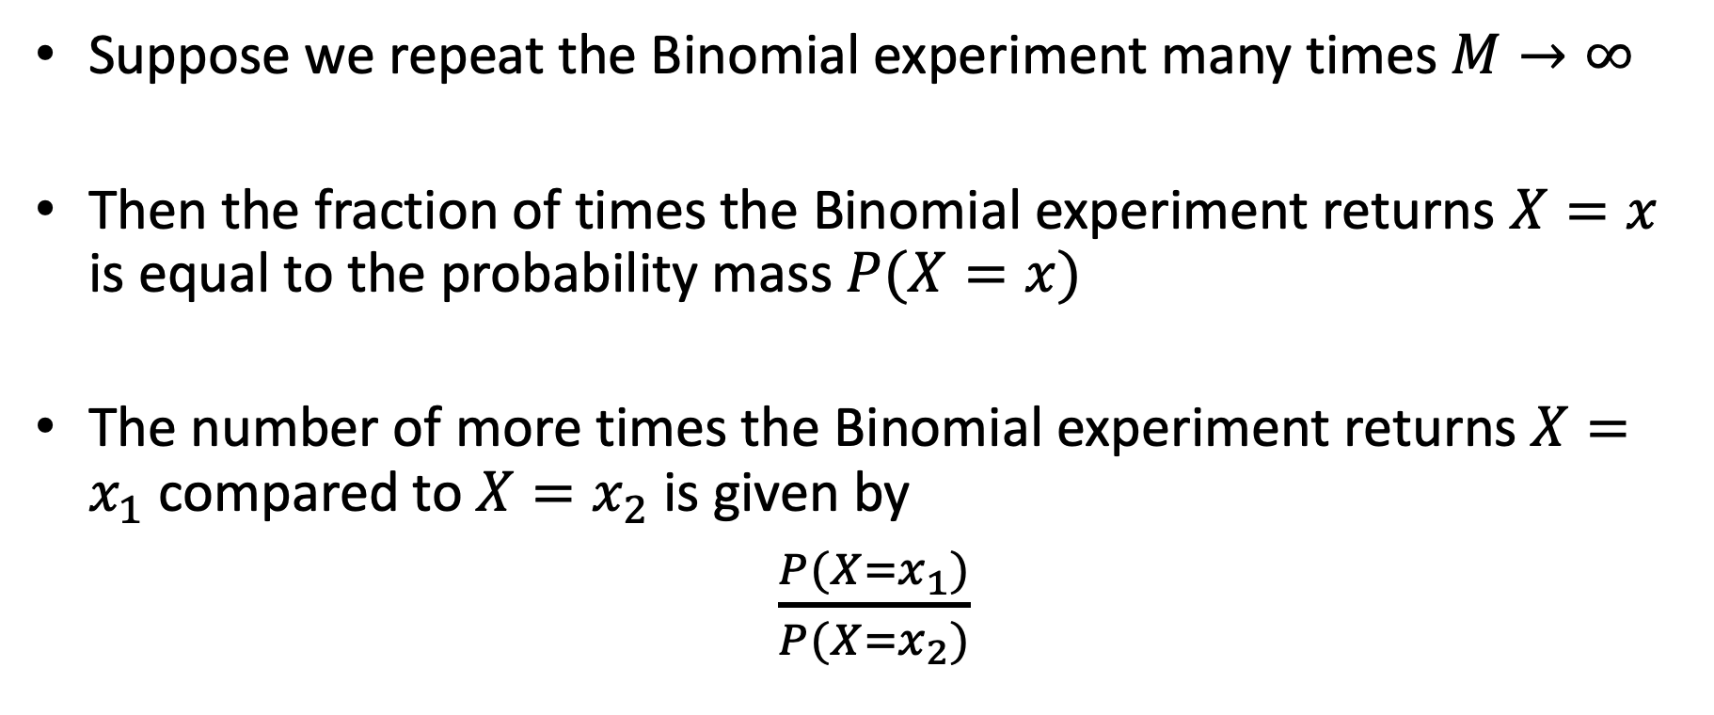
Repeated Binomial Experiments
Suppose we repeat the Binomial experiment many times $M→∞$
Then the fraction of times the Binomial experiment returns $X=x$ is equal to the probability mass $P(X=x)$
The number of more times the Binomial experiment returns $X=x_{1}$ compared to $X=x_{2}$ is given by
$\frac{P(X=x_{1})}{P(X=x_{2})}$

Slide 10
Lets return to the question
Imagine a large urn filled with marbles, half are red and half are white. Consider an experiment where we draw four balls, and record the number of red balls. Then we repeat the experiment many times. How much more often would we observe the expected outcome of “2 red and 2 blue” in comparison to the extreme outcome “4 red”?
Use a Binomial calculator as a tool to assist.

Slide 11
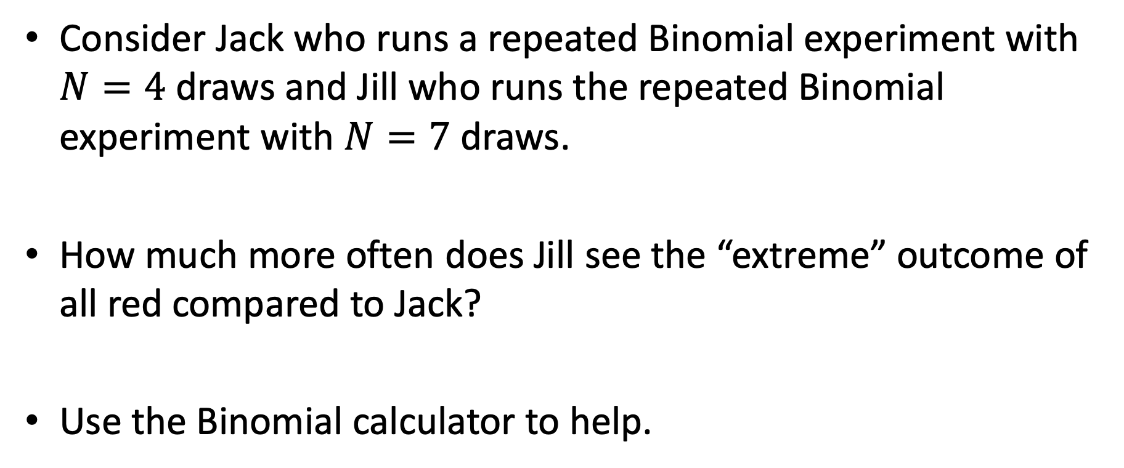
Changing the sample size
Consider Jack who runs a repeated Binomial experiment with $N=4$ draws and Jill who runs the repeated Binomial experiment with $N=7$ draws.
How much more often does Jill see the “extreme” outcome of all red compared to Jack?
Use the Binomial calculator to help.

Slide 12
Now solve the mystery
What does this reveal is the real “cause” of the conflicting new stories on kidney cancer?

Slide 13
Practice problem
“Many researchers have sought the secret of successful education by identifying the most successful schools in the hope of discovering what distinguishes them from the others.

Slide 14
The law of small numbers
The key factor is not Republican or rural it is sparsely populated.
Small samples are more likely to yield extreme outcomes – this is a purely statistical phenomena.
Yet people treat small samples as representative of the larger sample from which they come (later to be called the “representative heuristic”), and overinterpret the data.
Notes:
An accident of sampling. Many facts about the world are due to random chance. System 1 will have a tendency to create strong cognitive ease/coherence and over-infer.

Slide 15
Random Sequences
Consider the following sequence of boy and girl births at a hospital. What is their relative likelihood (most likely, etc)
BBBGGG
GGGGGG
BGBBGB

Slide 16
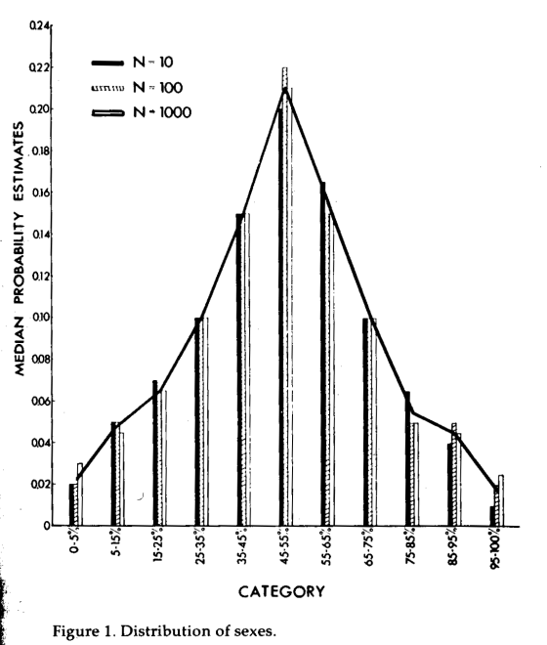
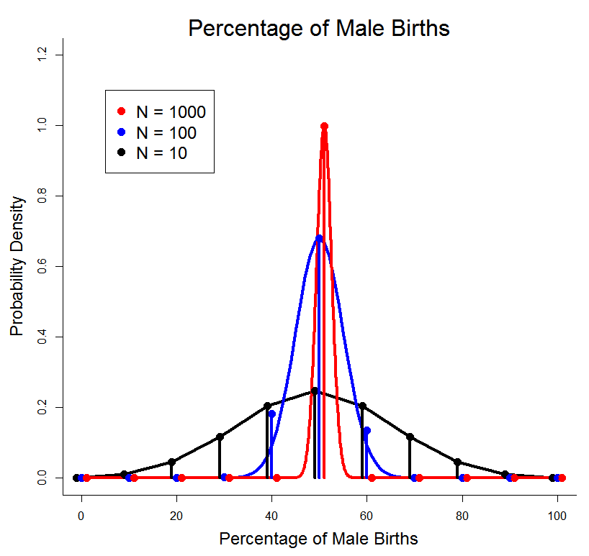
Intuitive Sampling Distributions
Question: Approximately N = 1000 (or 100 or 10) babies are born each day in a certain region. What percentage of the days will have the number of boys among 1000 babies as follows: 0 to 50? 50 to 150? 150 to 250? .... 850 – 950? 950 – 1000?
Notes:
R-code for the graphic is at ‘e:\p466\intuitive.sampling.dist.docm’

Slide 17
Causes Trump Statistics
System 1 is not prone to doubt, suppresses ambiguity, and automatically constructs stories that are coherent. (what alternatives could have happened is the essence of statistical thinking but violates WYSATI)
The WYSATI produces exaggerated faith in small samples that exaggerates consistency and coherency of the world relative to the actual reliability of the data.

Slide 18
But what about the law of large numbers?
System 2 knows the ”law of large numbers”.
But does not know it well enough to counteract the swift confidence of System 1.
Reprogramming a cognitive illusion can defy even experts
Notes:
Even with a stats education (and professors of economics and statistics) it takes some mental effort to see the equivalence of the two: Large samples are more precise than small samples
Small samples yield extreme results more often than large samples do
“The first statement has a clear ring of truth, but until the second version makes intuitive sense, you have not truly understood the first”.

Slide 19
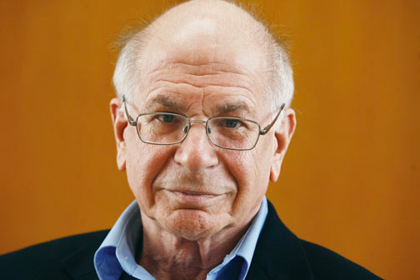
Human Bias
I’ve been studying intuition for 45 years, and I’m no better than when I started. I make extreme predictions. I’m over-confident. I fall for every one of the biases.”

Slide 20
Even the best of us can’t resist the lure of cognitive ease over plain old statistics
Its just hard to see unless you have immense practice (even among practitioners!)

Slide 21
Economics : The Log of Zero Problem
Lets think about the research design for understanding whether death penalty has a deterrence effect on homicide?

Slide 22
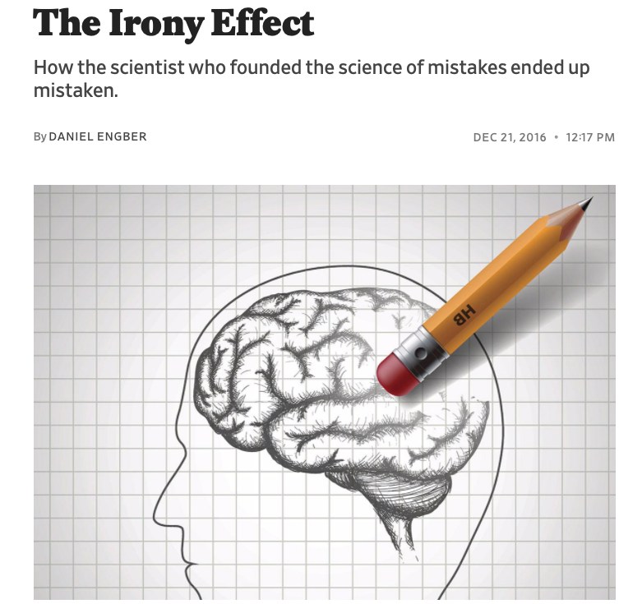
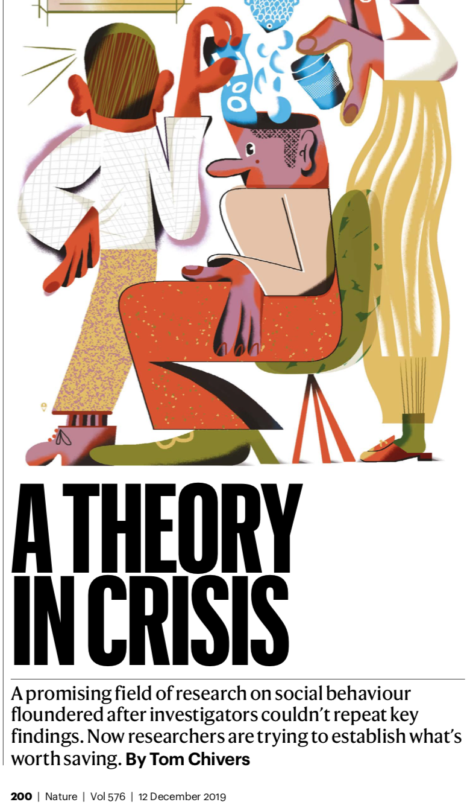
Scientific Crisis in Social Priming Studies

Slide 23
The Florida Effect
Assemble 4 word sentences from 5 words
Eg: “finds he it yellow instantly”
One group scrambled sentences include
Florida, forgetful, old, grey, wrinkle
Asked to walk to another room…
Notes:
Walked significantly slower than others – didn’t notice words with theme, insisted could not have been influenced

Slide 24

Voting
Arizona ballot to increase school funding

Slide 25
Voting
Support greater when in a school
Also when exposure to pictures of classrooms & school lockers increased support
bigger than parents

Slide 26
Some notable additions from the lit
Subtle reminders about money…..
Holding warm coffee…..
Listening to the Beatles “When I’m 64”

Slide 27

Disbelief is not an option
“Disbelief is not an option…The results are not made up, nor are they statistical flukes. You have no choice but to accept that the major conclusions of these studies are true. More important, you must accept that they are true about you.” (TFS, p. 57)

Slide 28
The replication crisis
“I don’t know a replicable finding. Its not that there isn’t one, but I can’t name it”
“I’ve gone from being full believer to full skeptic”
`when he read the relevant part of Kahneman’s book, “I was like, not one of these studies will replicate. And so far, nothing has”

Slide 29
The Irony Effect
Kahneman and Tversky anticipated the problem in their first paper in 1971 “BELIEF IN THE LAW OF SMALL NUMBERS”
“Apparently, most psychologists have an exaggerated belief in the likelihood of successfully replicating an obtained finding. The sources of such beliefs, and their consequences for the conduct of scientific inquiry, are what this paper is about. Our thesis is that people have strong intuitions about random sampling; that these intuitions are wrong in fundamental respects; that these intuitions are shared by naive subjects and by trained scientists; and that they are applied with unfortunate consequences in the course of scientific inquiry. “

Slide 30
Belief in the Law of Small Numbers
The strong bias towards believing that small samples closely resemble the population from which they are drawn is also part of a larger story: The exaggerated faith of researchers in what can be learned from a few observations is closely related to the halo effect, the sense we often get that we know and understand a person about whom we actually know very little. System 1 runs ahead of the facts in constructing a rich image on the basis of scraps of evidence. A machine for jumping to conclusions will act as if it believed in the law of small numbers. (TFS p 114)

Slide 31
A Confession
See the blog Replicability-index

Slide 32
What is happening
People find something in the data
It accords with what they believe should be true (confirmation bias)
It gels with a causal account for explaining the phenomena
The role that chance is playing in explaining their finding is ignored (System 1 beats a busy System 2)

Slide 33
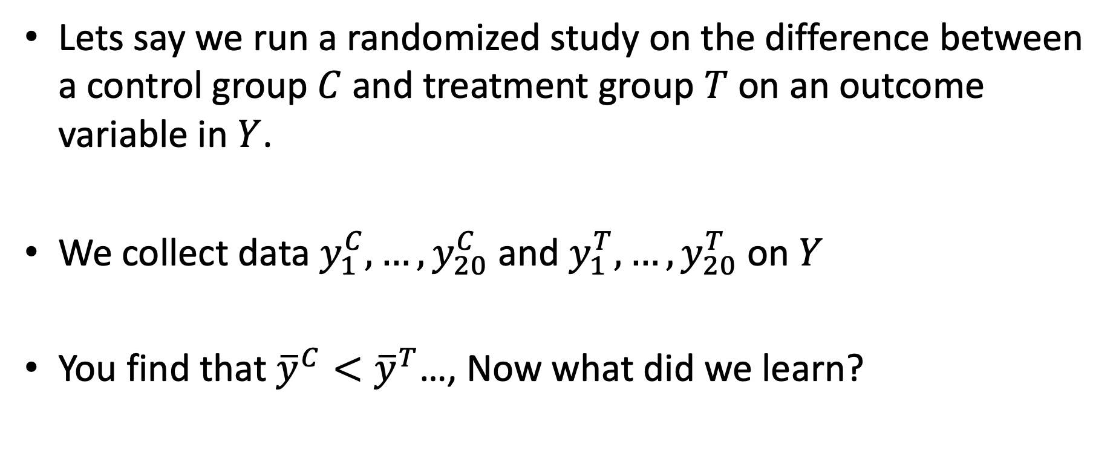
Lets understand what is happening
Lets say we run a randomized study on the difference between a control group $C$ and treatment group $T$ on an outcome variable in $Y$.
We collect data $y_{1}^{C},…,y_{20}^{C}$ and $y_{1}^{T},…,y_{20}^{T}$ on $Y$
You find that ${\overline{y}}^{C}<{\overline{y}}^{T}$…, Now what did we learn?

Slide 34
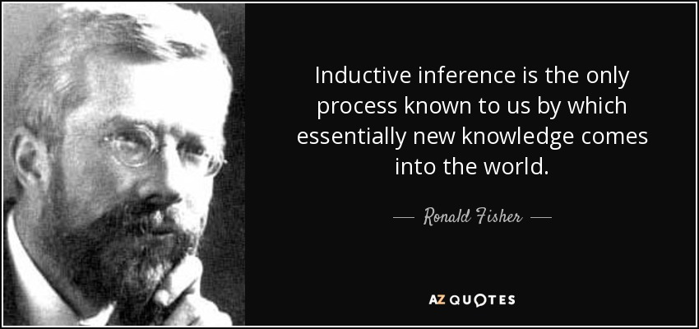

Slide 35
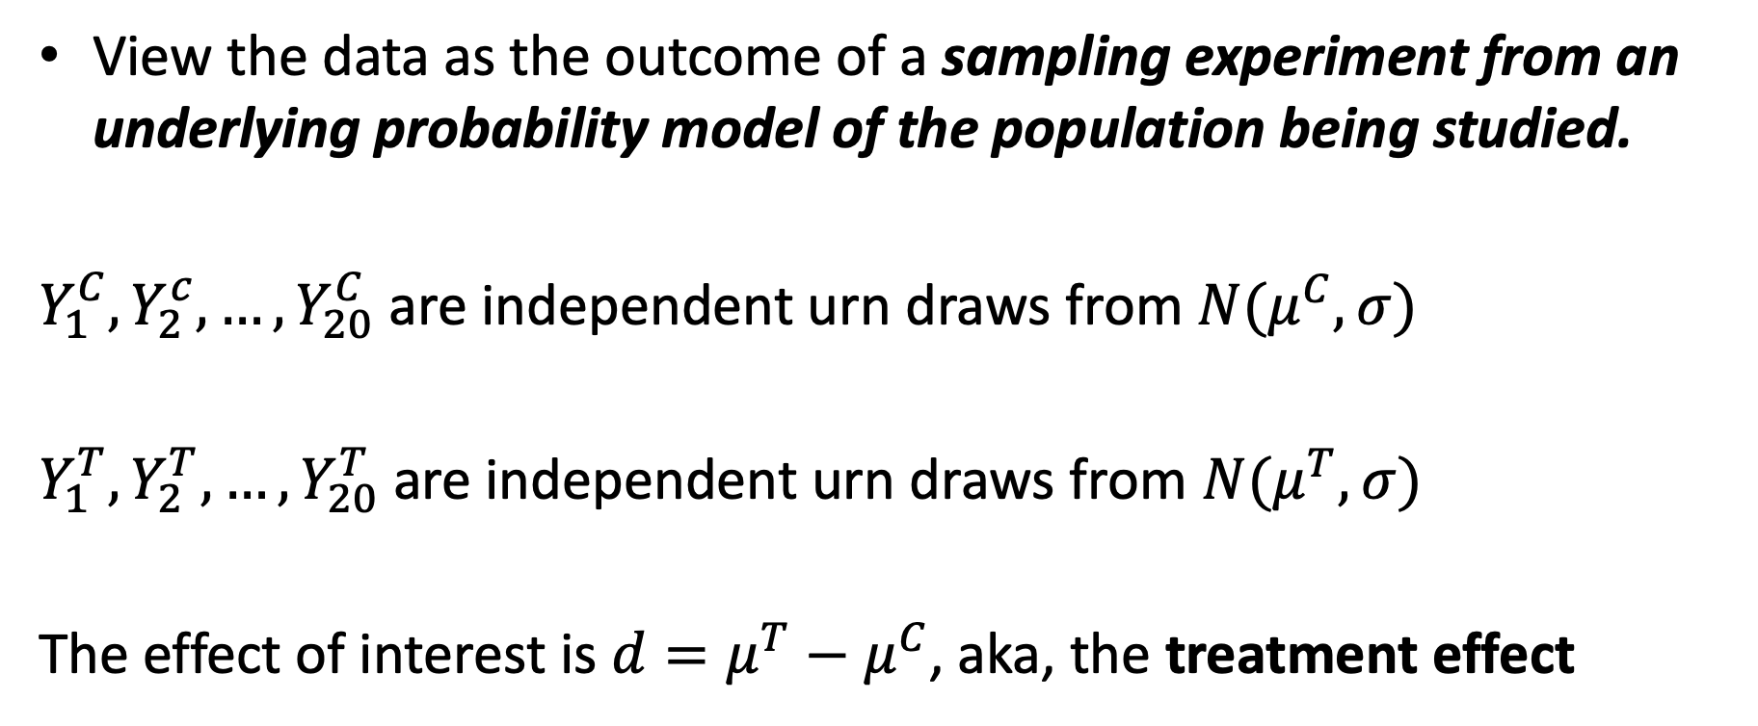
Treatment effect
View the data as the outcome of a sampling experiment from an underlying probability model of the population being studied.
$Y_{1}^{C},Y_{2}^{c},…,Y_{20}^{C}$ are independent urn draws from $N(μ^{C},σ)$
$Y_{1}^{T}, Y_{2}^{T},…,Y_{20}^{T}$ are independent urn draws from $N(μ^{T},σ)$
The effect of interest is $d=μ^{T}−μ^{C}$, aka, the treatment effect

Slide 36
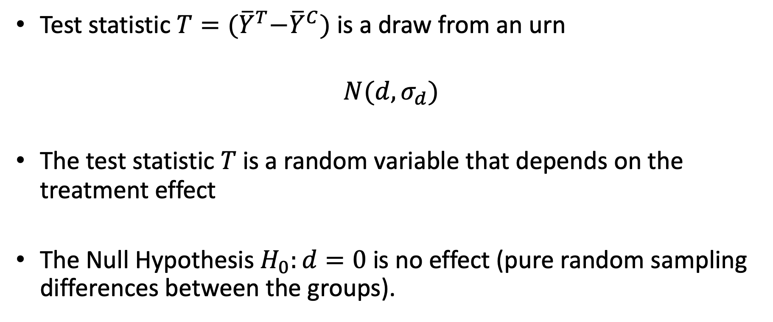
The Null
Test statistic $T={(\overline{Y}}^{T}−{\overline{Y}}^{C})$ is a draw from an urn
$$N(d,σ_{d})$$
The test statistic $T$ is a random variable that depends on the treatment effect
The Null Hypothesis $H_{0}:d=0$ is no effect (pure random sampling differences between the groups).

Slide 37
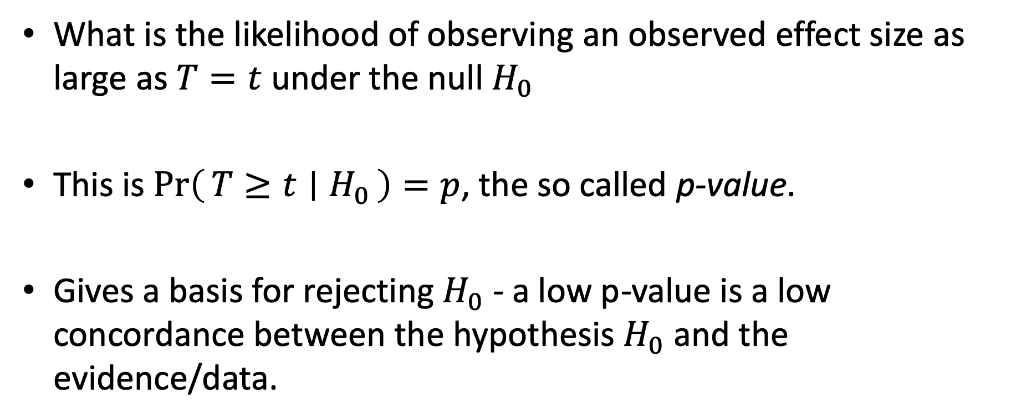
The p-value
What is the likelihood of observing an observed effect size as large as $T=t$ under the null $H_{0}$
This is $\operatorname{Pr}\left(T≥t ∣ H_{0}\right)=p$, the so called p-value.
Gives a basis for rejecting $H_{0}$ - a low p-value is a low concordance between the hypothesis $H_{0}$ and the evidence/data.

Slide 38
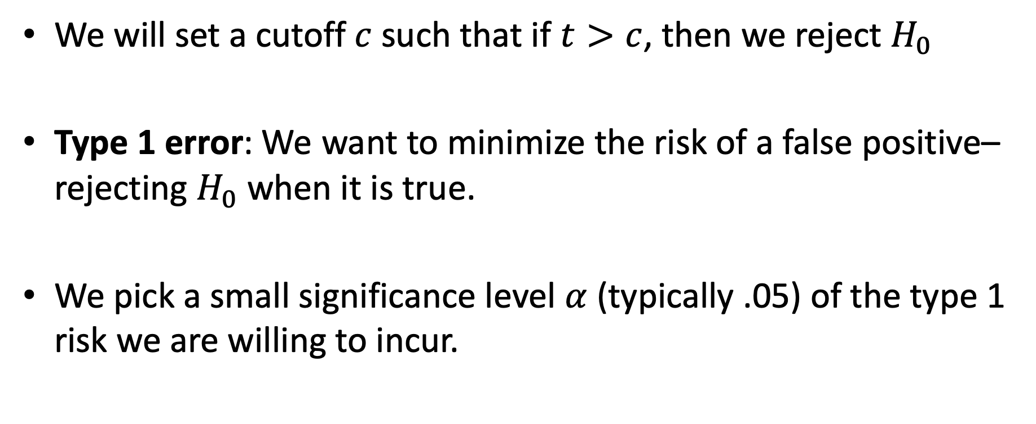
The significance level
We will set a cutoff $c$ such that if $t>c$, then we reject $H_{0}$
Type 1 error: We want to minimize the risk of a false positive– rejecting $H_{0}$ when it is true.
We pick a small significance level $α$ (typically .05) of the type 1 risk we are willing to incur.

Slide 39
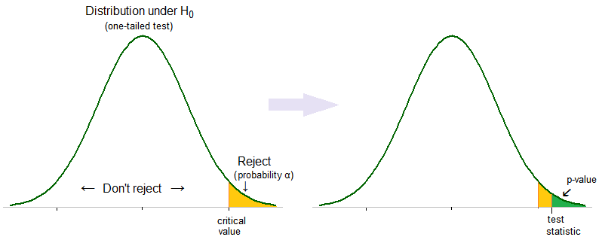

Slide 40
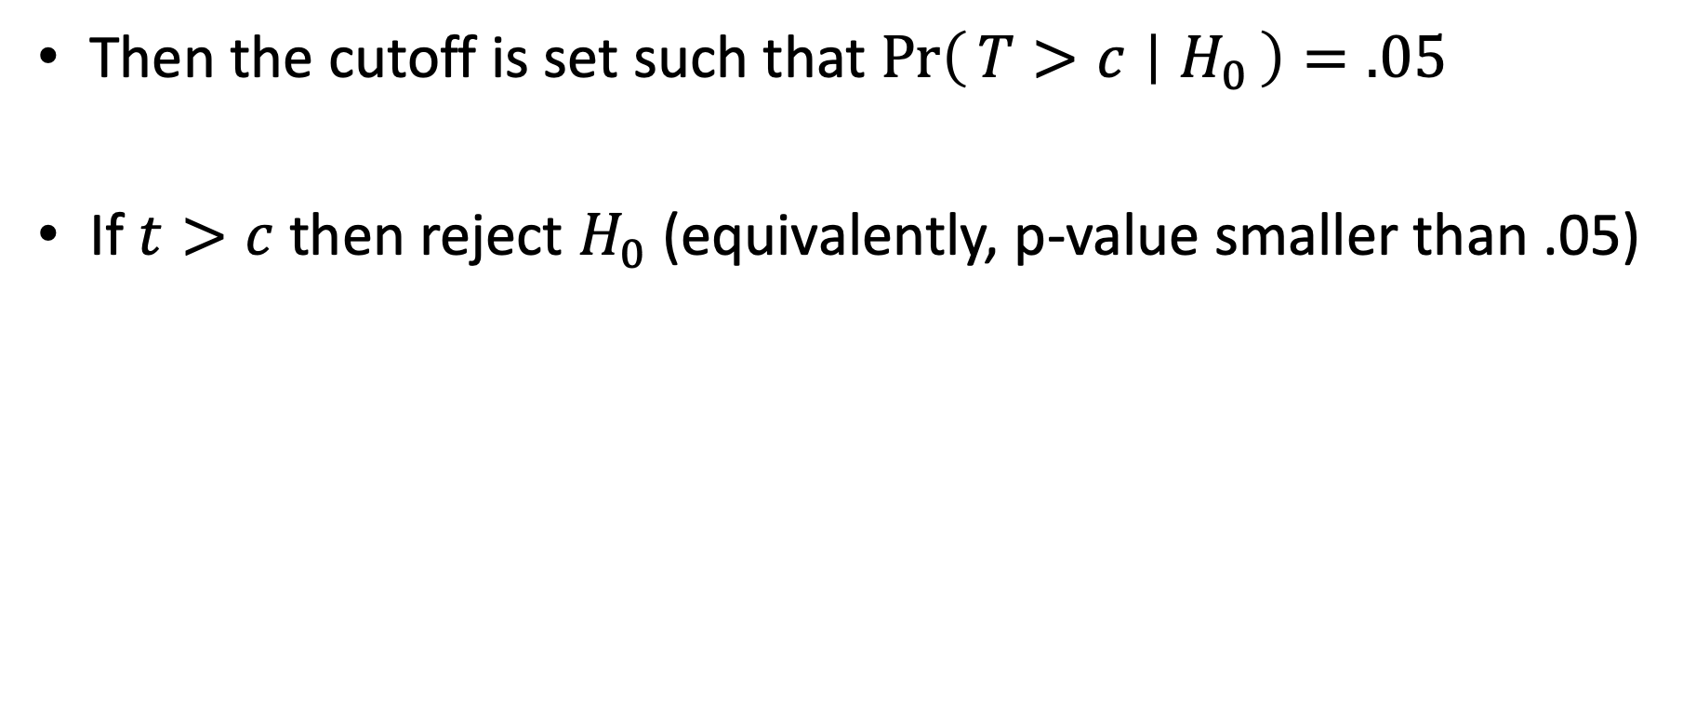
The significance test
Then the cutoff is set such that $\operatorname{Pr}\left(T>c ∣ H_{0}\right)=.05$
If $t>c$ then reject $H_{0}$ (equivalently, p-value smaller than .05)

Slide 41
What did we learn exactly?
Lets say you reject the null? Do you now have greater confidence in your theory as an explanation of the data.
Notes:
We didn’t really test our theory (there is a priming effect) but rather a “null hypothesis” of no effect? But what does our actual theory/ predict should have happened in the data

Slide 42
The P-value: What the heck is it anyway?
The American Statistical Association (ASA) warns about improper use and interpretation of the p-value on March 8th, 2016 (6); its Statement consists of 6 principles:
P-value can indicate how incompatible the data are with a specified statistical model.
P-value neither measures the probability that the studied hypothesis is true nor the probability that the data were produced by random chance alone.
Scientific conclusions and business or policy decisions should not be based only on whether a p-value passes a specific threshold.
Proper inference requires full reporting and transparency.
A p-value, or statistical significance, does not measure the size of an effect or the importance of a result.
By itself, a p-value does not provide a good measure of evidence regarding a model or hypothesis.”

Slide 43
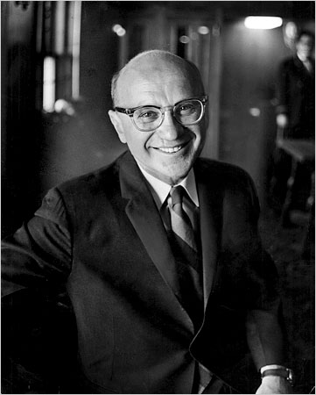
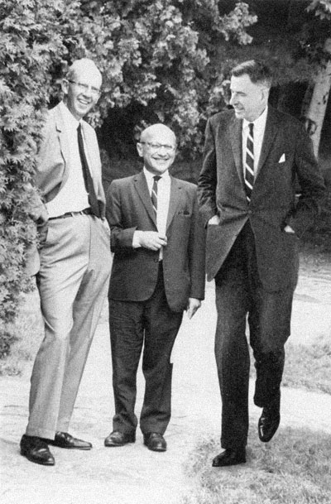
What would Friedman say?
Notes:
We didn’t really test our theory (there is a priming effect) but rather a “null hypothesis” of no effect? But what does our actual theory/ predict should have happened in the data. That is what is missing under a pure Fisherian frame.

Slide 44
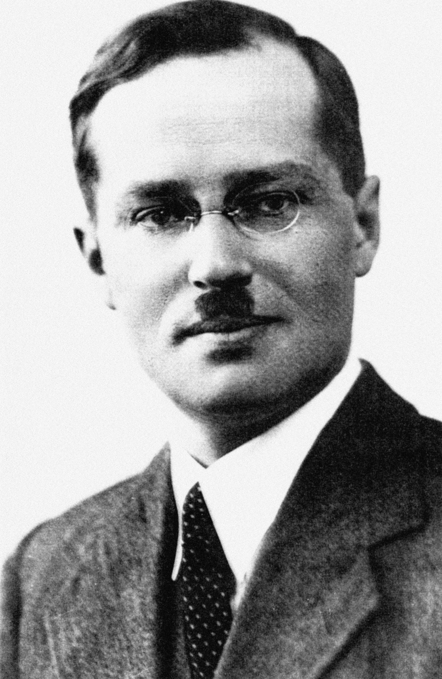
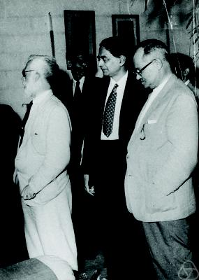
Enter the “Alternative”
Jerzy Neyman and Egon Pearson’s theory of statistical tests extend Fisher’s significance testing framework

Slide 45
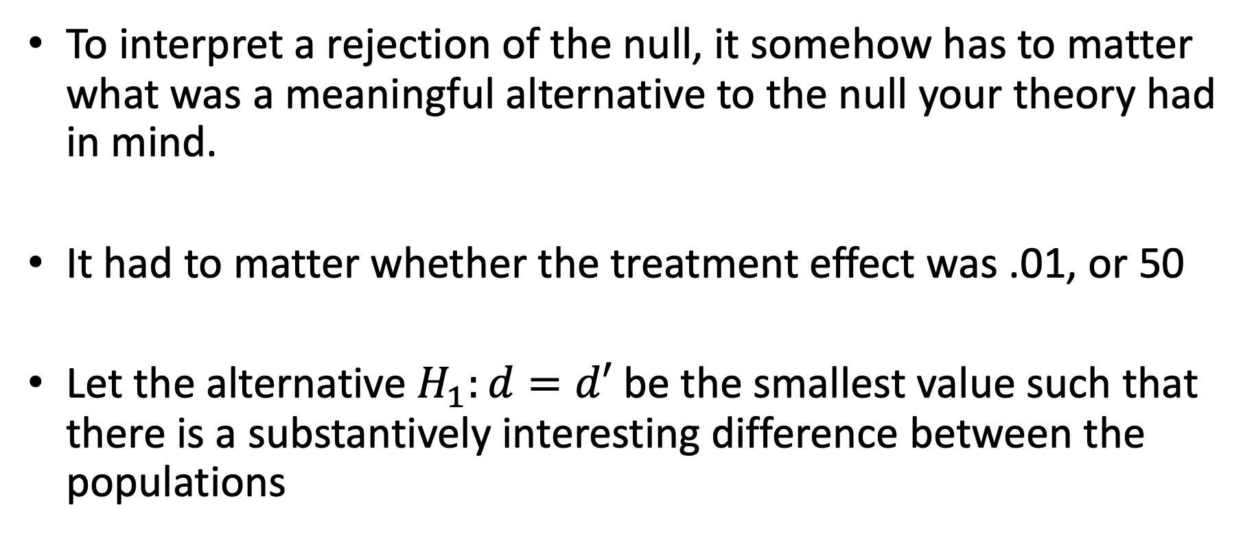
The idea
To interpret a rejection of the null, it somehow has to matter what was a meaningful alternative to the null your theory had in mind.
It had to matter whether the treatment effect was .01, or 50
Let the alternative $H_{1}:d=d′$ be the smallest value such that there is a substantively interesting difference between the populations

Slide 46
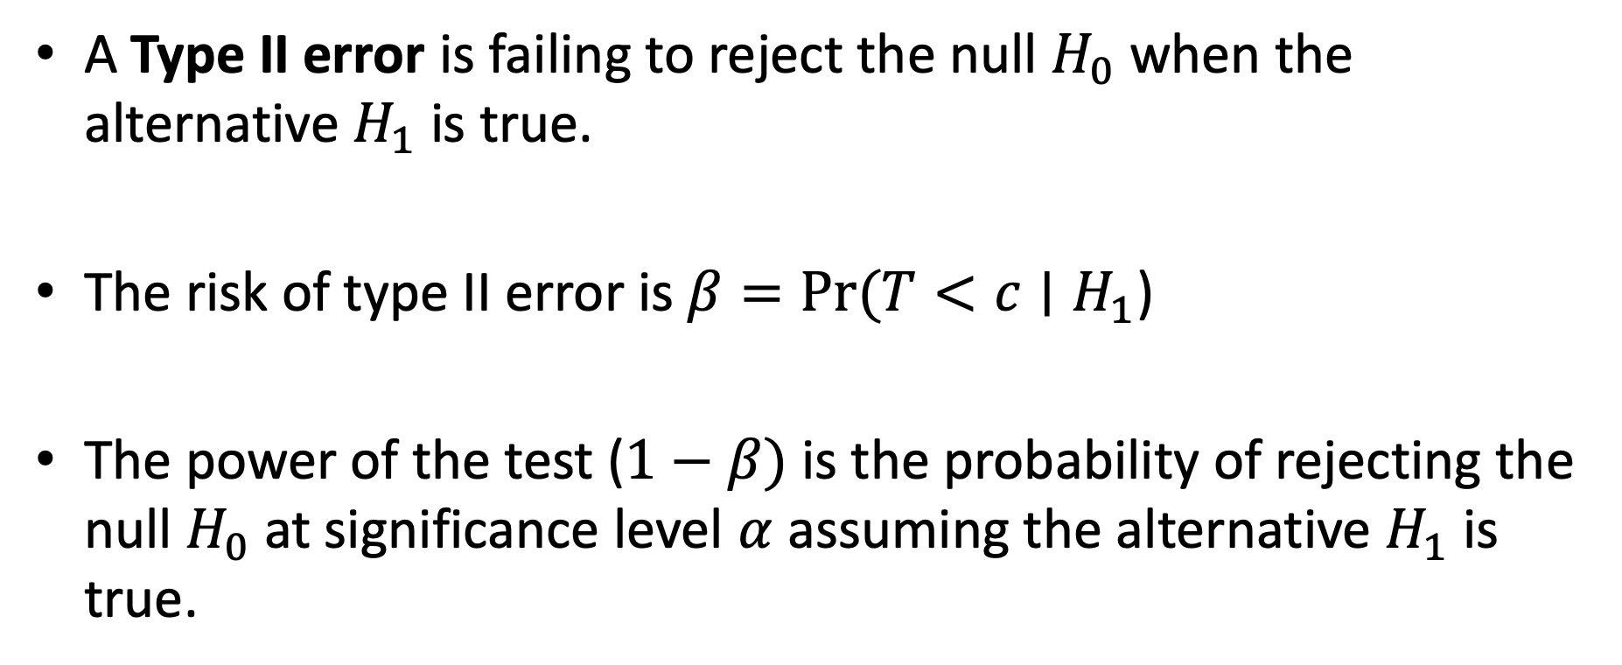
Power vs Significance
A Type II error is failing to reject the null $H_{0}$ when the alternative $H_{1}$ is true.
The risk of type II error is $β=Pr⁡(T<c∣H_{1}$)
The power of the test ($1−β)$ is the probability of rejecting the null $H_{0}$ at significance level $α$ assuming the alternative $H_{1}$ is true.

Slide 47
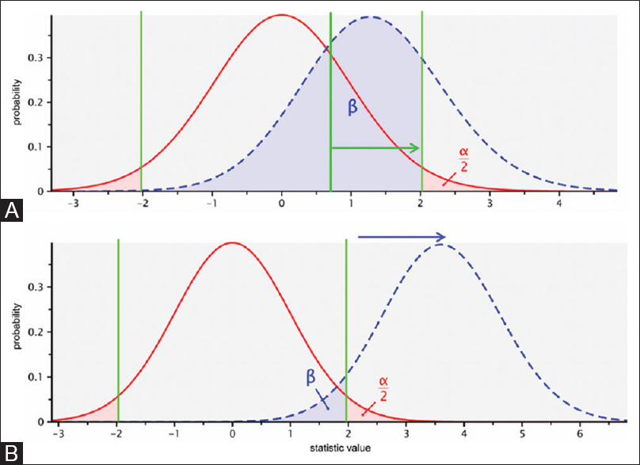

Slide 48
A high powered test provides a likely outcome that should hold under our theory, and a clear interpretation of the outcome – rejecting is evidence in favor of the alternative, and failing to reject is evidence in favor of the null.

Slide 49
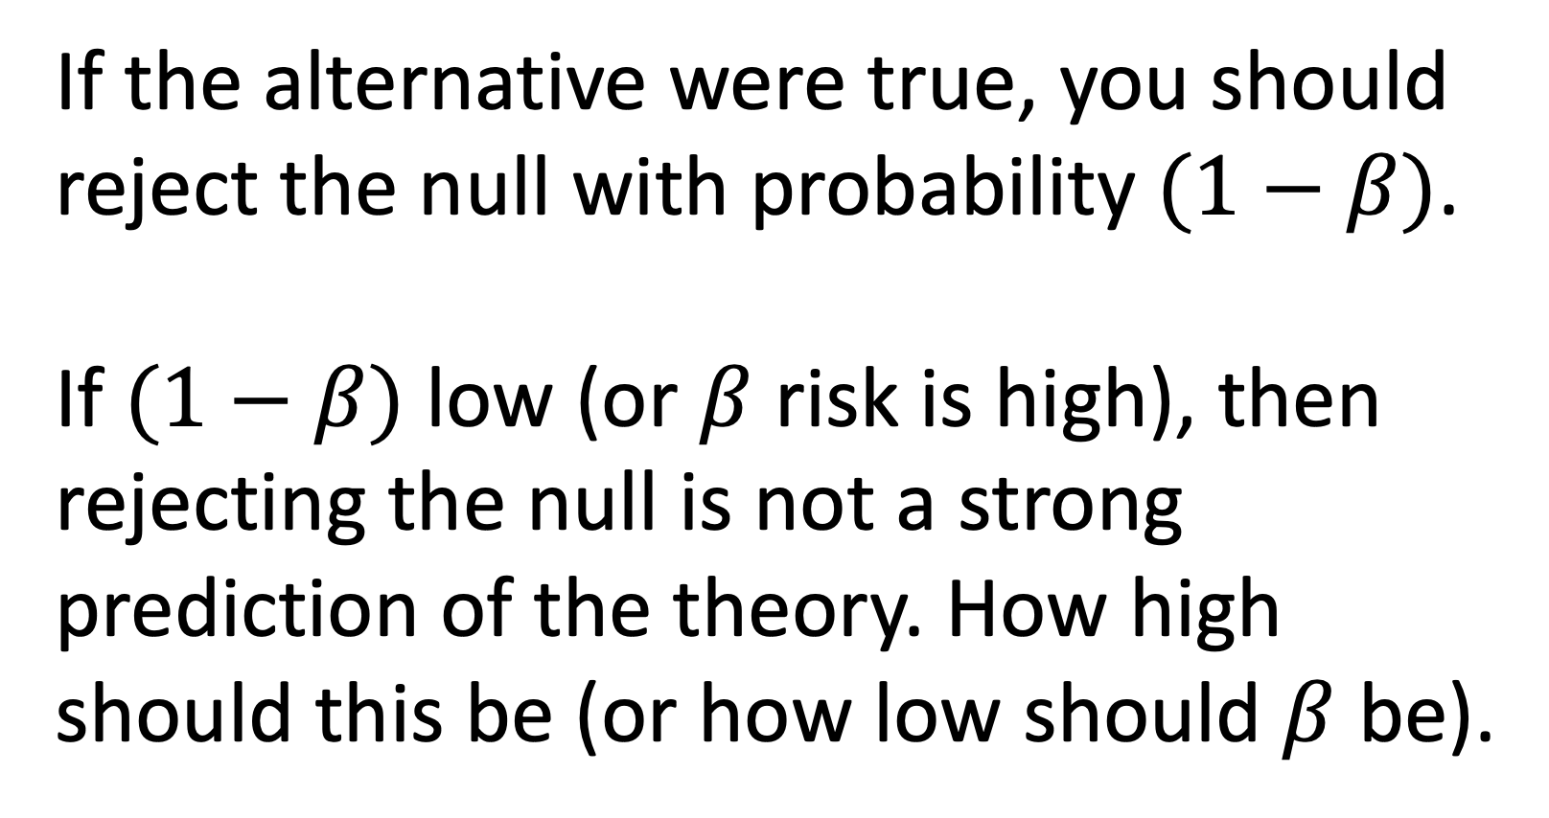
If the alternative were true, you should reject the null with probability $(1−β)$.
If $(1−β)$ low (or $β$ risk is high), then rejecting the null is not a strong prediction of the theory. How high should this be (or how low should $β$ be).

Slide 50
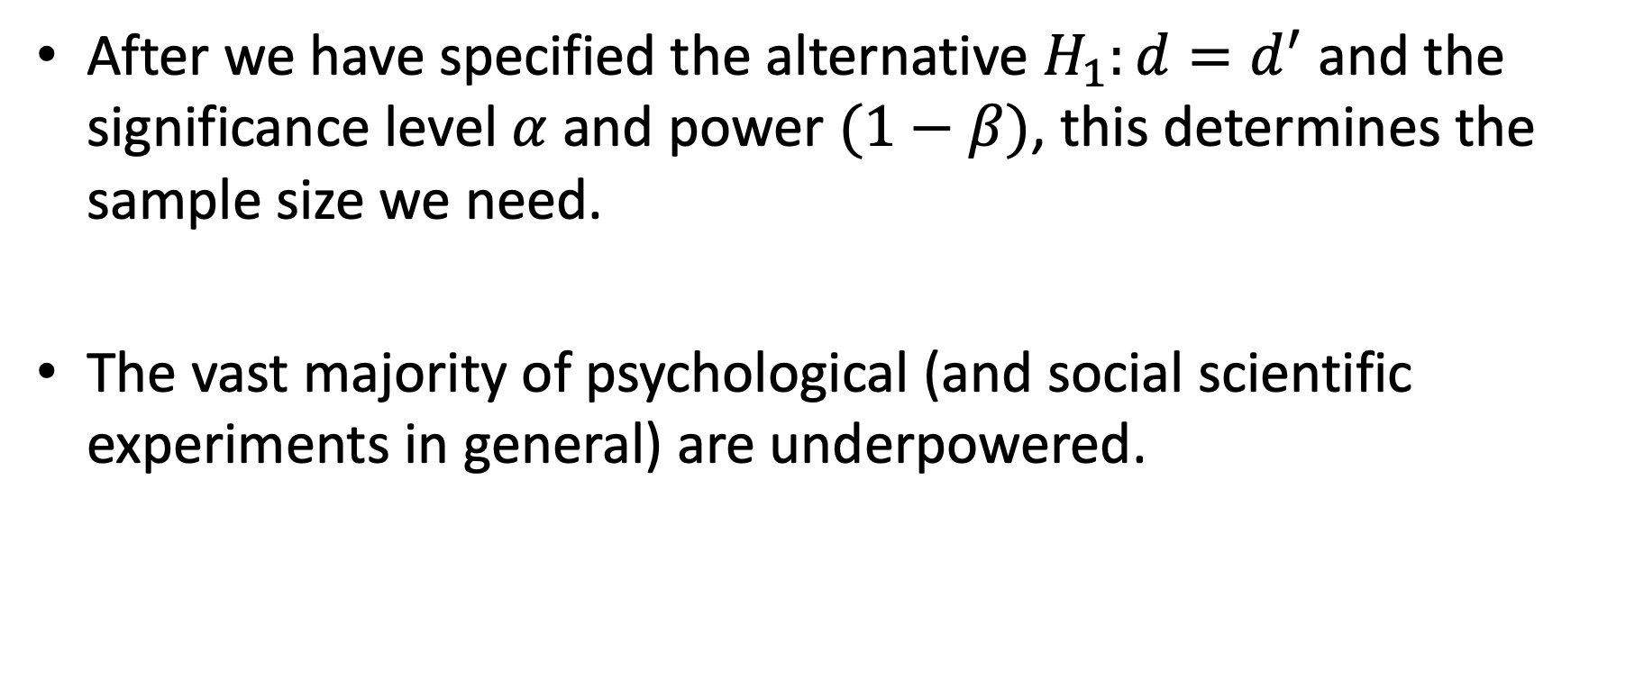
Research Design
After we have specified the alternative $H_{1}:d=d^{′}$and the significance level $α$ and power $(1−β)$, this determines the sample size we need.
The vast majority of psychological (and social scientific experiments in general) are underpowered.

Slide 51
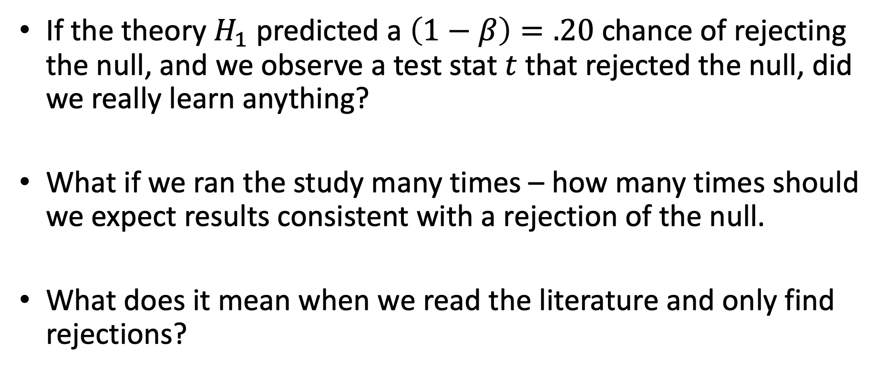
Consequences
If the theory $H_{1}$ predicted a $\left(1−β\right)=.20$ chance of rejecting the null, and we observe a test stat $t$ that rejected the null, did we really learn anything?
What if we ran the study many times – how many times should we expect results consistent with a rejection of the null.
What does it mean when we read the literature and only find rejections?
Notes:
Publication bias: what are the real sample of outcomes sitting in the file drawers. What we really would like to have seen is the the same finding (a rejection of the null) to have reproduced were we to run the experiment again?. The real sample in the file drawers under a low powered study will show lots of “failures to reject”.

Slide 52
The Human Incentive Problem
Why not attract grants to fund large scale experiments for social priming effects (with the right power)
If it reveals trivial effect sizes is it still interesting in relation to surprising effect sizes that are collected rapidly with smaller groups?

Slide 53
The end result is a pernicious state of affairs
Apparently scientific methods are encouraging false beliefs in weak hypotheses among scientists!
System 1 wins over a lazy System 2
Statistics is just plain hard to fully internalize (unless System 2 fully engaged) even among and we don’t benefit enough from it in our daily decisions and lives.

